Slide 1

Social Conditioning through Children’s Toys

Slide 2
Social conditioning means the way we’re encouraged to think and behave in order to fit into our society. Repetition enforces the message – so the more times you’re told something, the more likely you are to do it/believe it.
For example, maybe in your house you’ve been taught to take your shoes off when you go in? Over time, you get so used to doing this that when you visit someone else’s house, you take your shoes off even if they haven’t asked you.
You have been socially conditioned to behave a certain way.

Slide 3
People can be socially conditioned in all kinds of ways.
One of the most obvious ones is the way we divide up female/male. Have you heard any of the following messages?
Girls like pink and princesses. Boys like dinosaurs and diggers
Boys shouldn’t have long hair. Girls shouldn’t have really short hair.
It looks wrong.
Girls squeal and gossip. Boys fight and shout.
Boys will be boys.
That’s too girly.
Social conditioning is everywhere…

Slide 4
It’s even in your toys!
On the following slides, you’ll see two word clouds. These word clouds were put together by an organisation called Let Toys Be Toys.
They looked at lots and lots of TV adverts for children’s toys and the words that were used in those adverts.
They collected the words and made a note of which words appeared most frequently. Those words are the biggest ones in the word clouds.
Can you guess which word cloud belongs to which gender group…?

Slide 5
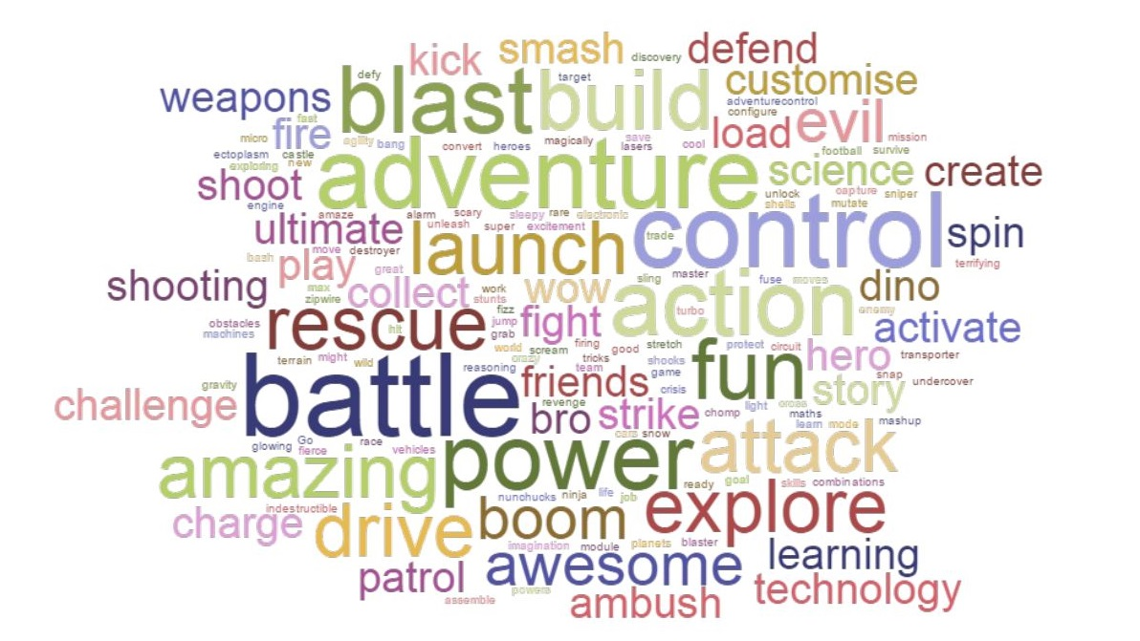

Slide 6
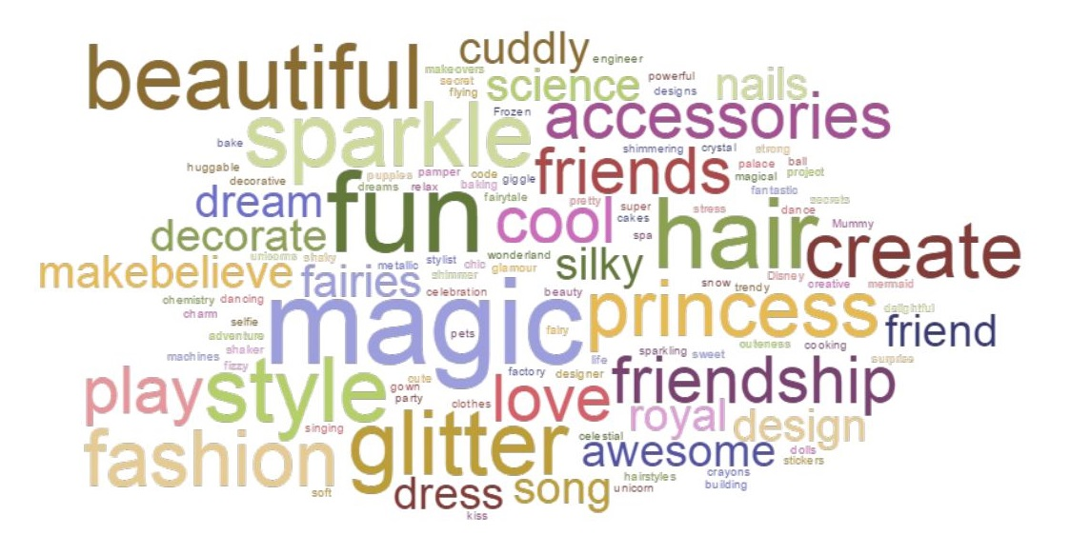

Slide 7
Here are the two word clouds side by side
Which one do you think came from words used in advertising to girls, and which one to boys?
How does this kind of advertising use social conditioning – and do you think this is a good thing or a bad thing?

Slide 8

Final thoughts:
Should boys be encouraged to play with dolls?
Are girls as powerful as boys?
Do girls like pale colours like pink and lilac more than black and navy?
Do boys ever have problems with friends? Should they be encouraged to be a good friend?
Are girls likely to be interested in science or technology?
Is it OK for boys to do ballet?
Think about the questions above – and then ask yourself:
Have I been socially conditioned..?
Resource created by Jo Cotterill 2018

