Slide 1
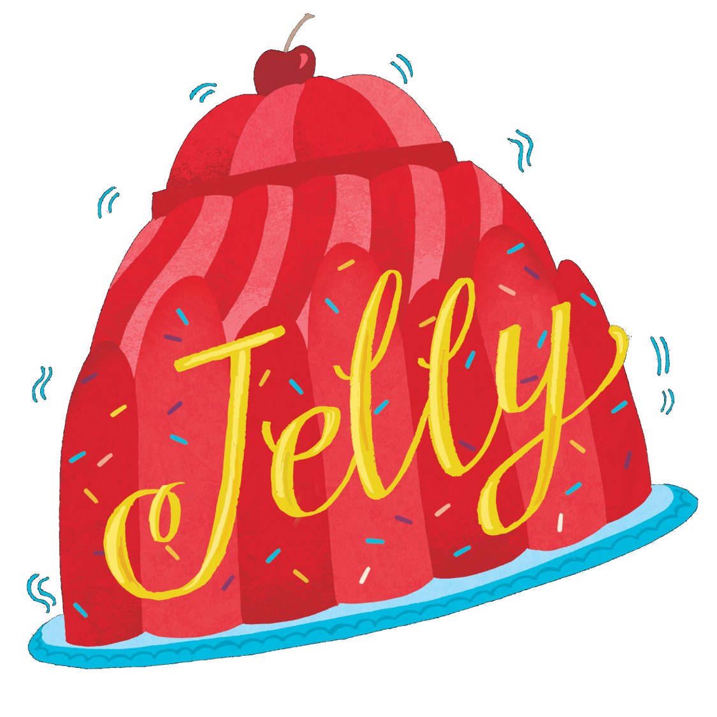
Alliterative Animal Poem

Slide 2
In Chapter 2 of Jelly, we read Jelly’s first poem, which is about a walrus.
Or is it?
In the next slide, author Jo Cotterill has analysed her own poem to show you all the tricks and techniques she used while writing it.
Look at it carefully…because then you’re going to write your own!

Slide 3
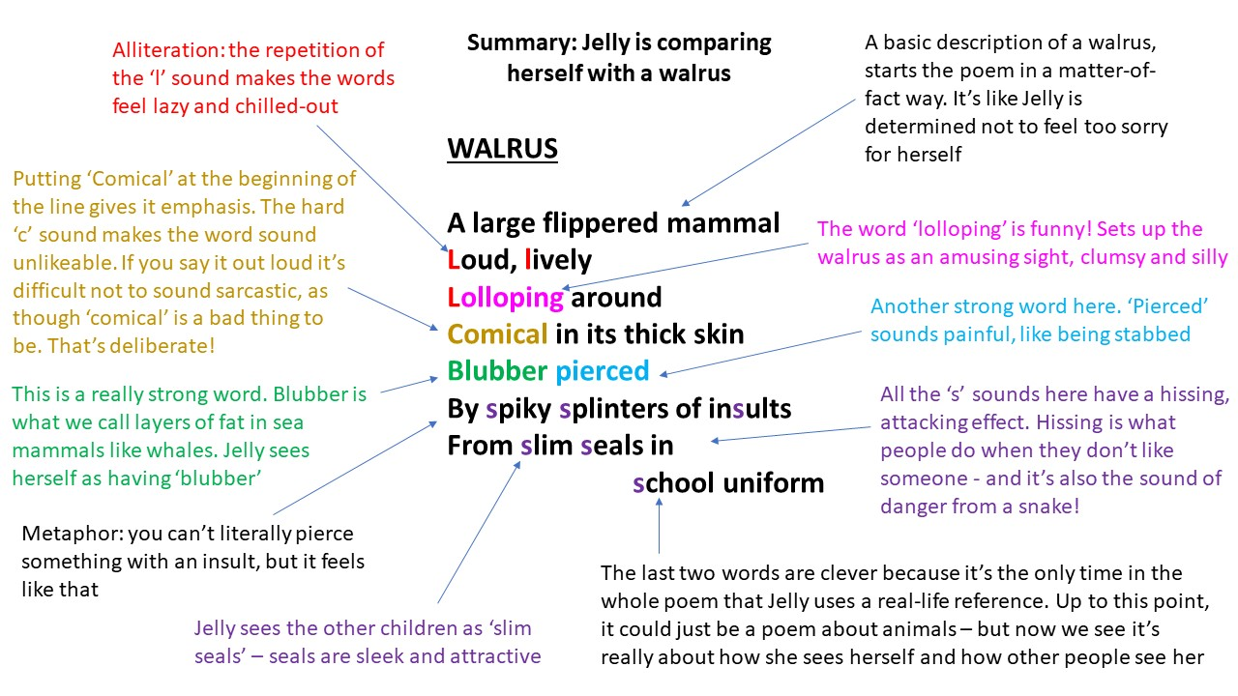

Slide 4
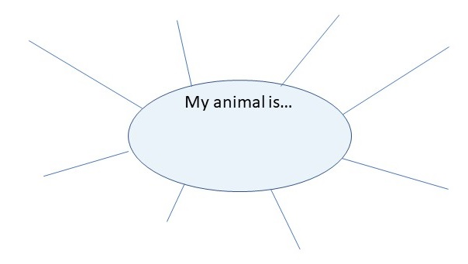
Now it’s your turn!
Choose an animal and create a mind map of words that describe it. Think about its appearance, its movements, its eating habits, its personality.
For example, if you were to choose ‘mouse’ then you might use words like ‘sniffle’, ‘soft’, ‘tiny’, ‘nervous’, ‘hiding’, ‘dash’, ‘nibble’.
Ha – now you can’t use mouse, sorry! That would be cheating! Find your own animal!

Slide 5
Use your mind map ideas to make phrases.
In my mouse example, I might write the following: Tiny nose sniffling for seeds.
Alliteration (where two or more words start with the same consonant sound) works really well in poetry, but don’t use it in every single line!
Write down your phrases in a list on a piece of paper until you have at least six.

Slide 6
Now, cut up your paper so that each phrase is on a different piece.
This is the fun bit!
Arrange your phrases in a different order to the one you wrote them in. Move them around. Read them aloud in the different orders.
Listen to the rhythm. Which order works best? You’re looking for rhythm and sense – the poem should flow from one line to the next. Perhaps you might need to add some more words, or a new phrase. How does it start and finish?
To be extra-clever: can you add something to your poem to give a hint that it might actually be about something else? A mouse could be a metaphor for someone hiding from bullies. Or a peacock might represent someone performing on stage. Can you give your poem extra depth? (Refer back to the Walrus poem to see how Jo Cotterill does this.)

Slide 7
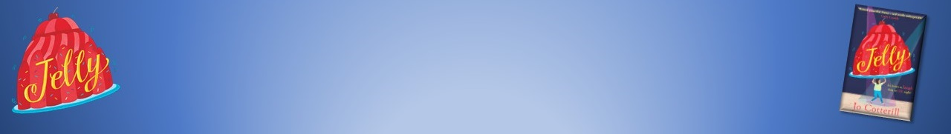
When you’re happy with the order of your phrases, write it all out again neatly.
Ta-dah! Finished poem! Congratulations!
Resource created by Jo Cotterill 2018

