Slide 1

Recognising Expressions

Slide 2
Did you know there are 43 muscles in the face?
Humans can make a wide range of expressions using these muscles, and often we don’t know we’re doing it.
Getting along with people, making friends, working together – all these things depend on being able to recognise other people’s feelings and intentions. We are Expression Detectives, searching for clues in other people all the time.
The face is the first place we look for these clues.
For example…

Slide 3
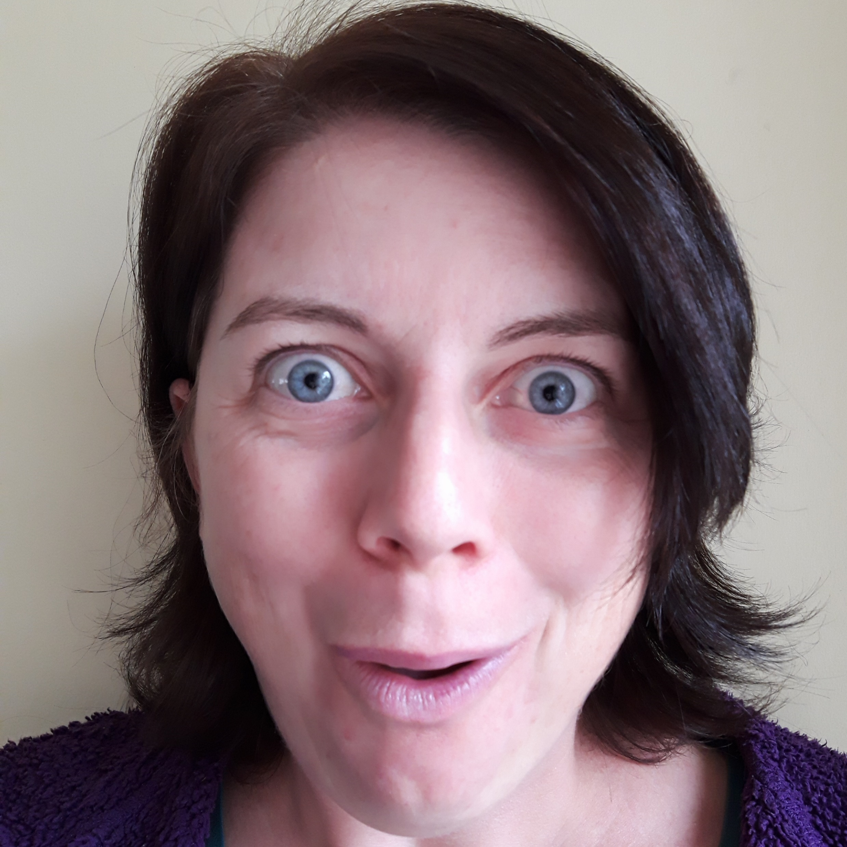
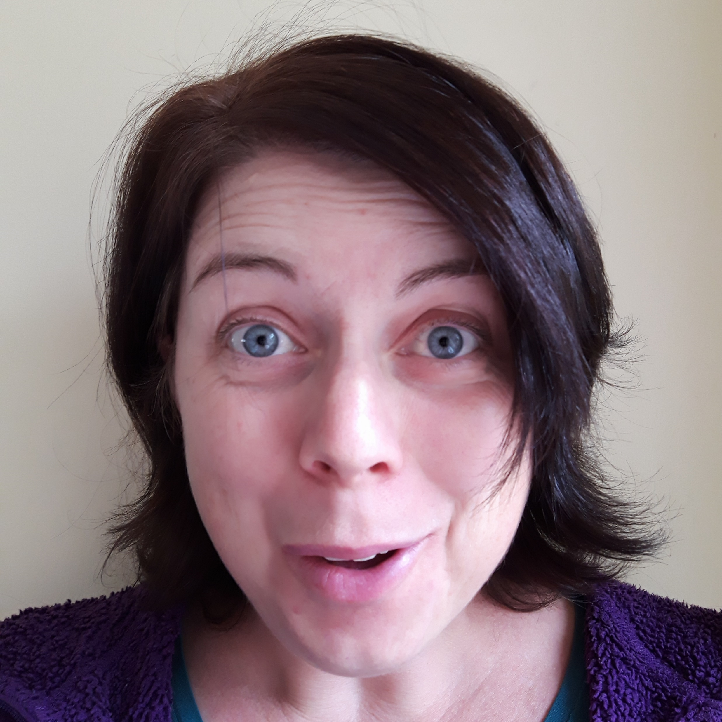
Here are two photos of author Jo Cotterill making very similar facial expressions. But they’re not quite the same.
What are the differences, and can you come up with something that Jo might be saying to accompany each picture?

Slide 4
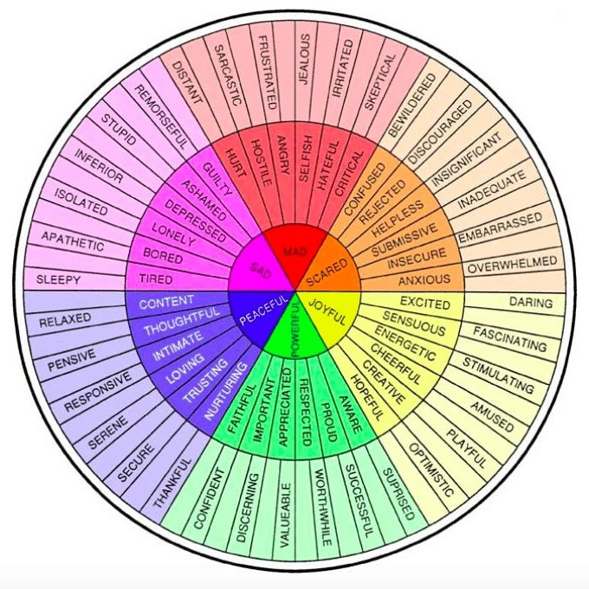
This is an Emotion and Feeling Wheel.
There are lots of different versions of it – this is just one.
As you can see, there are a LOT of words to describe the specific ways we feel. This wheel doesn’t even list half of them!
But it’s a good place to start.
How many of these words do you already know?

Slide 5
Now we’re going to see just how good you are at finding clues in a facial expression!
On the next slide are 12 photos of Jo making facial expressions (be afraid; be very afraid…!)
With a partner, can you agree on an ‘emotion word’ for each photo?
Take a few minutes to jot down your ideas.

Slide 6
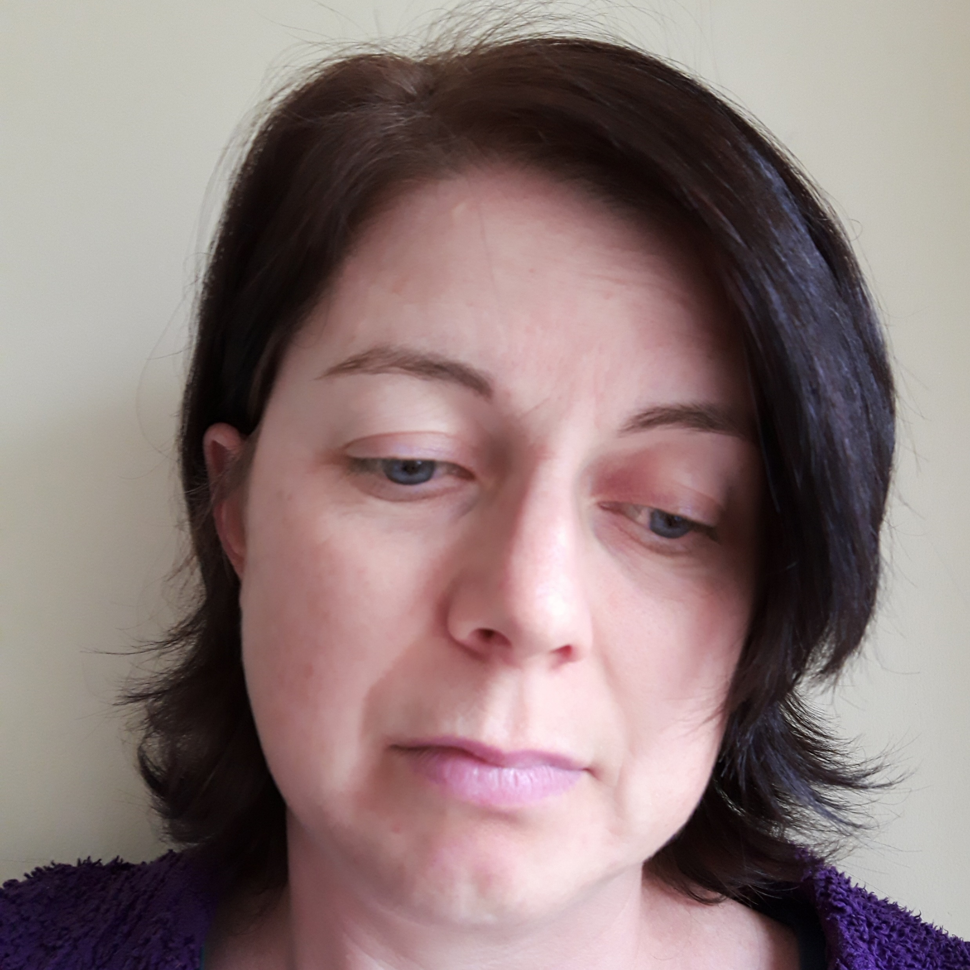
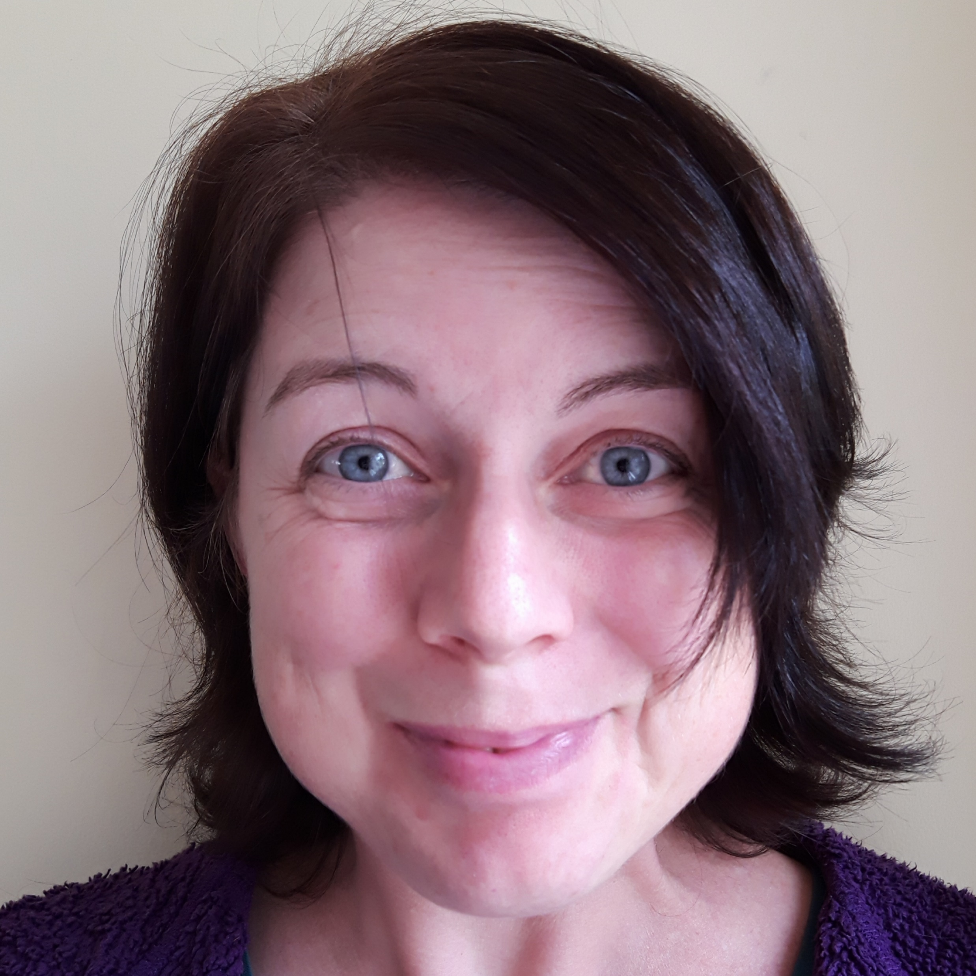
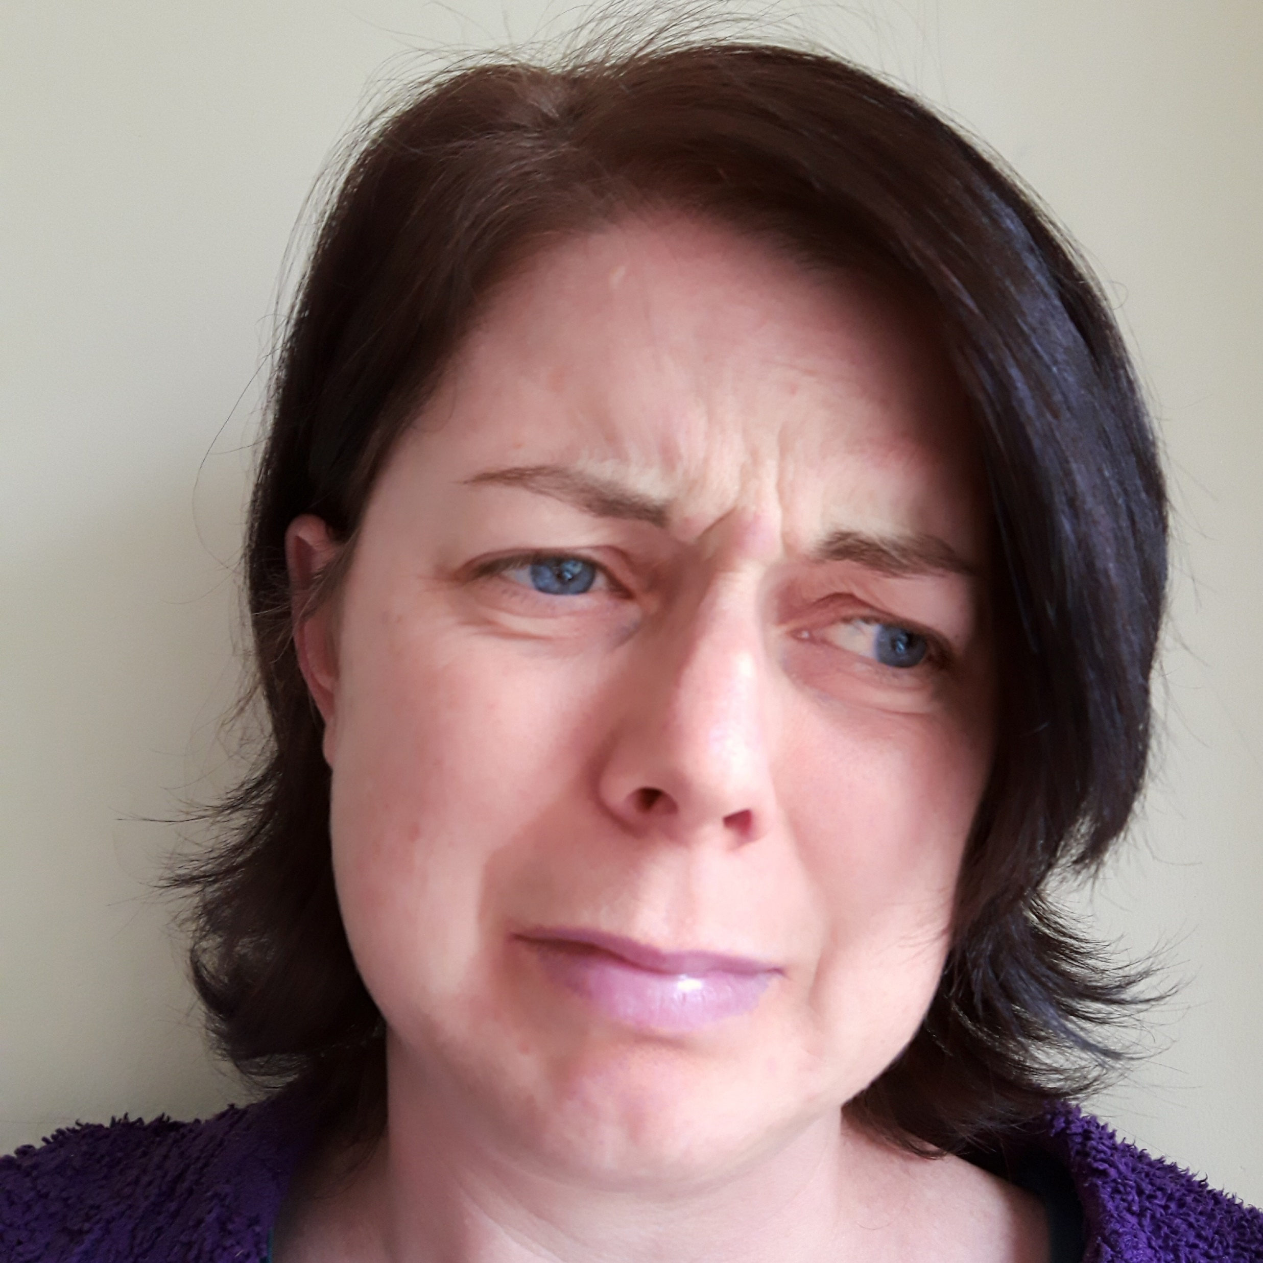
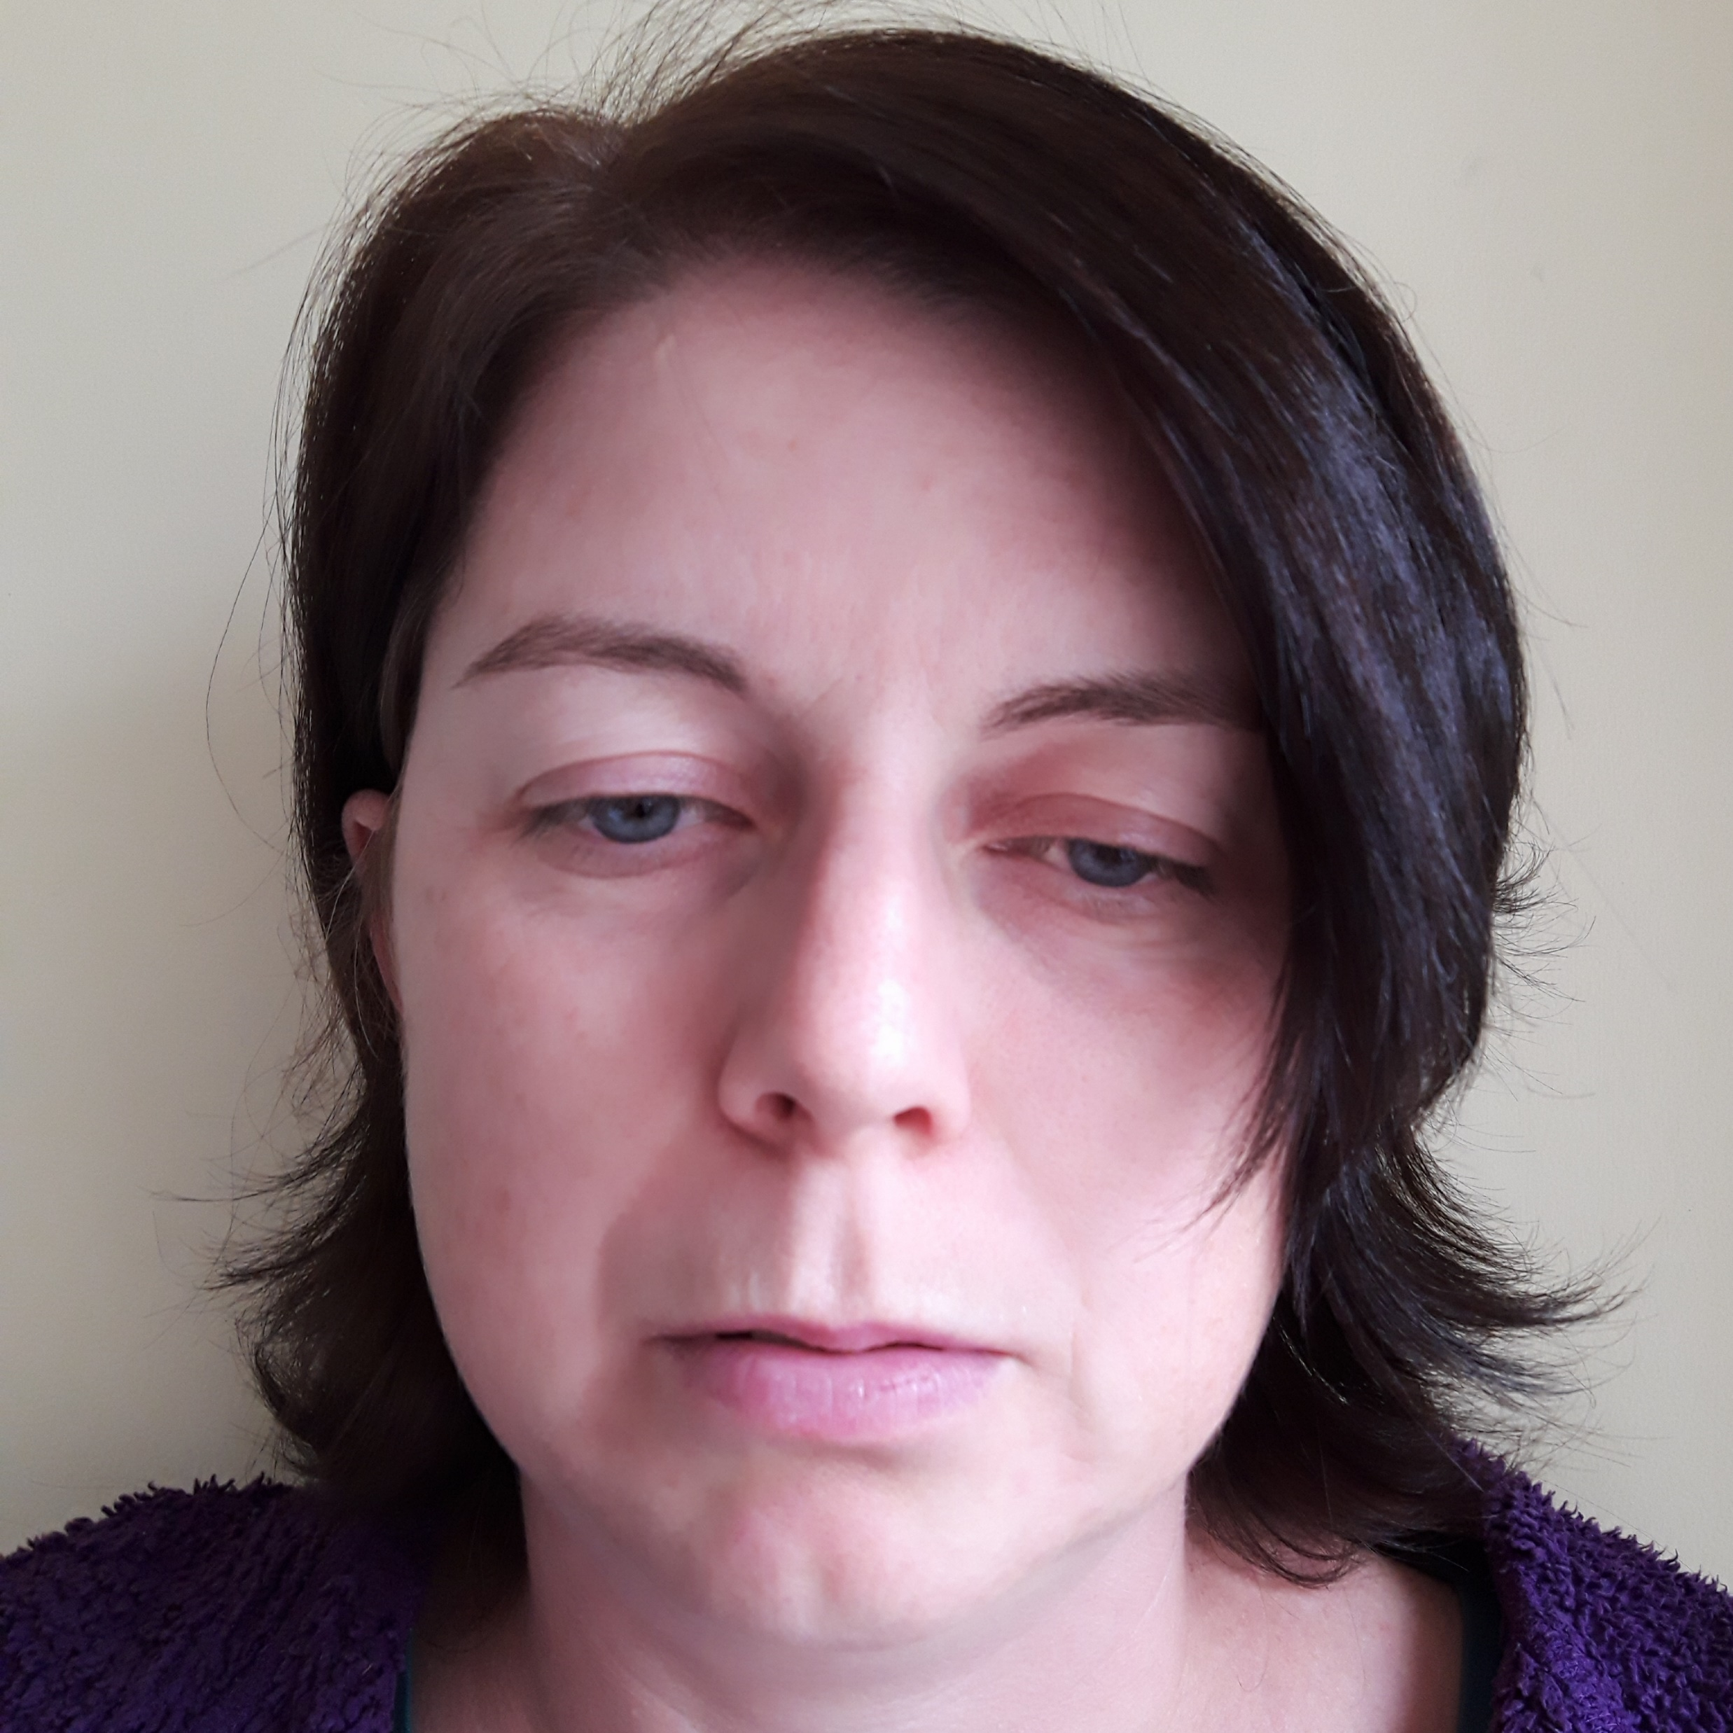
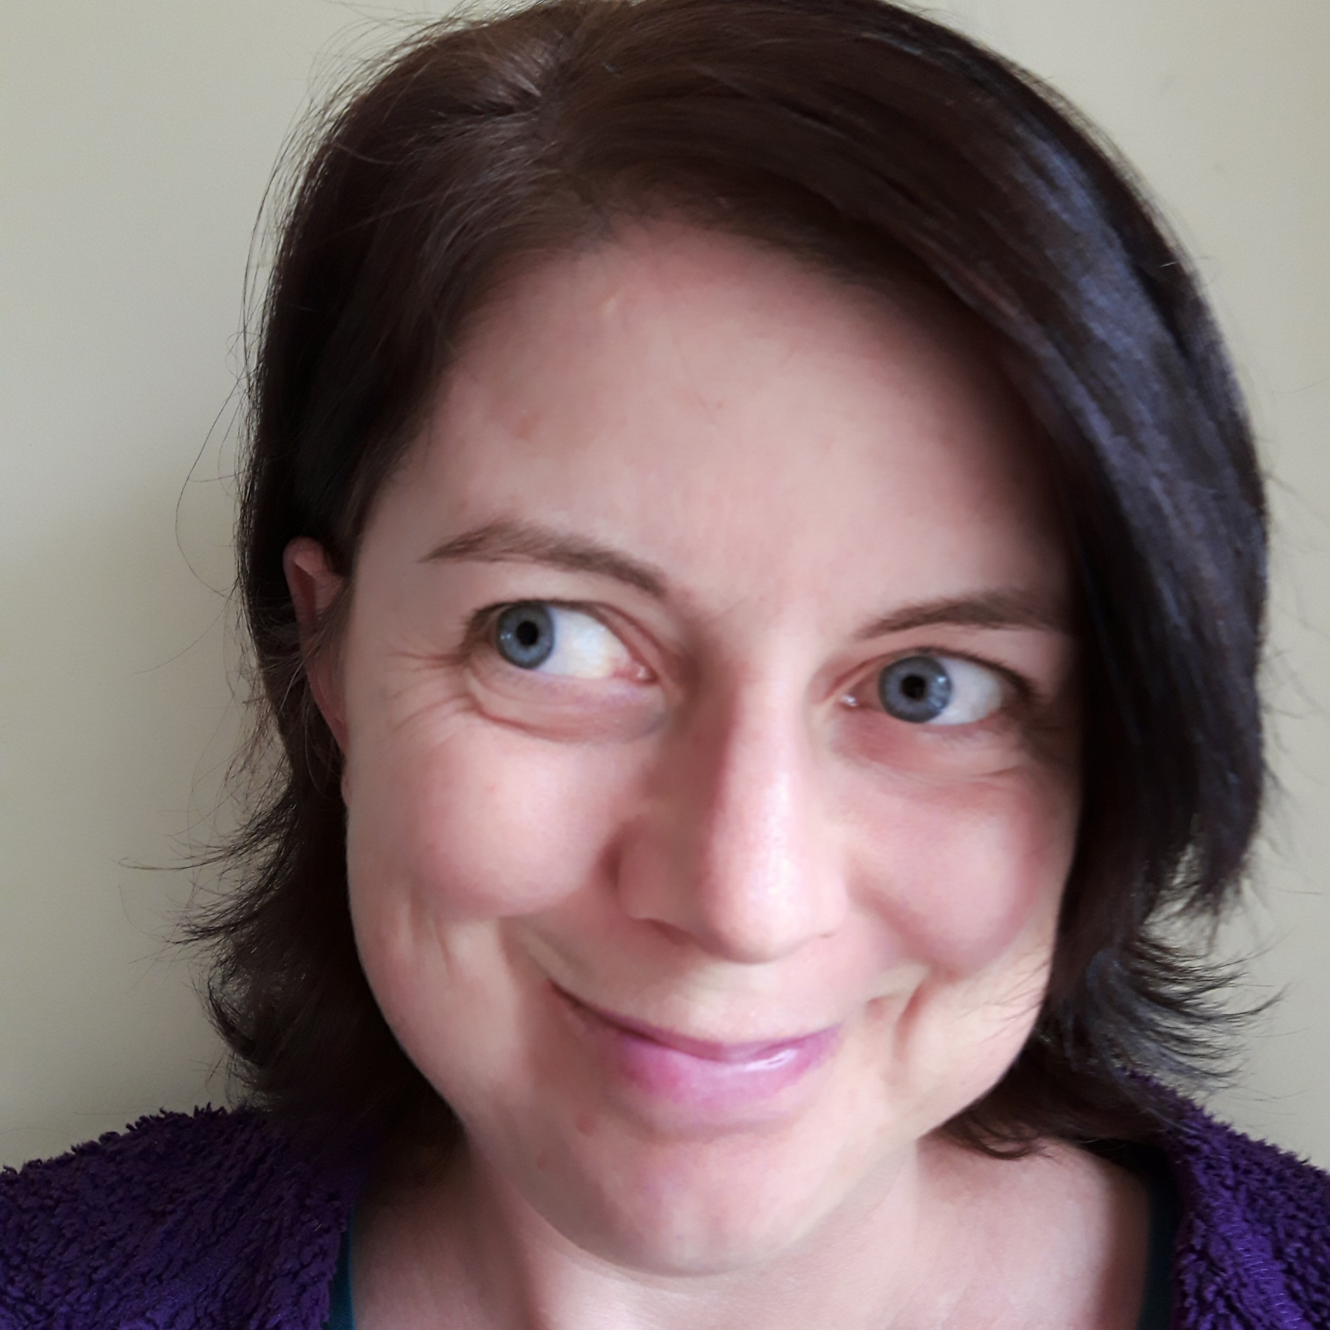
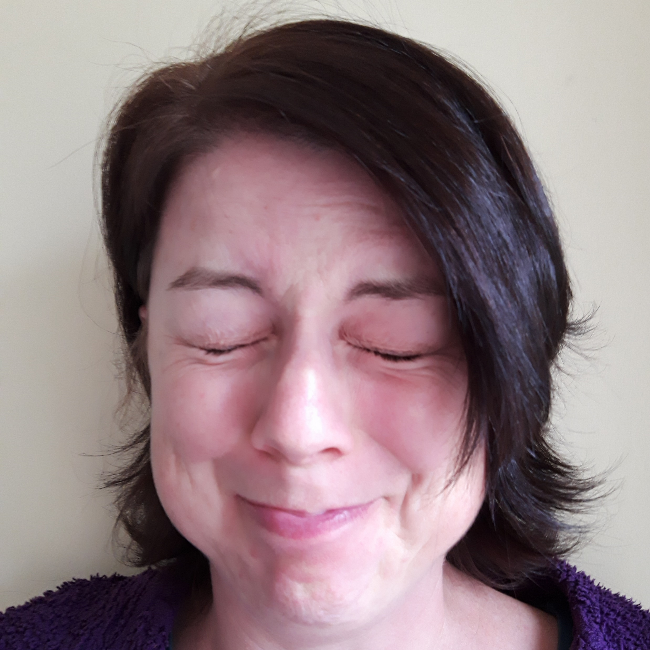
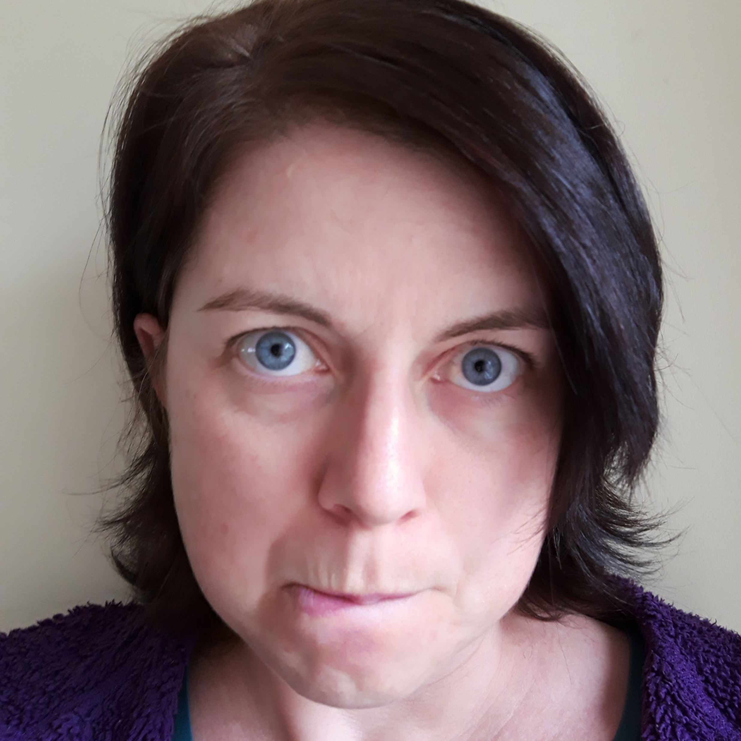
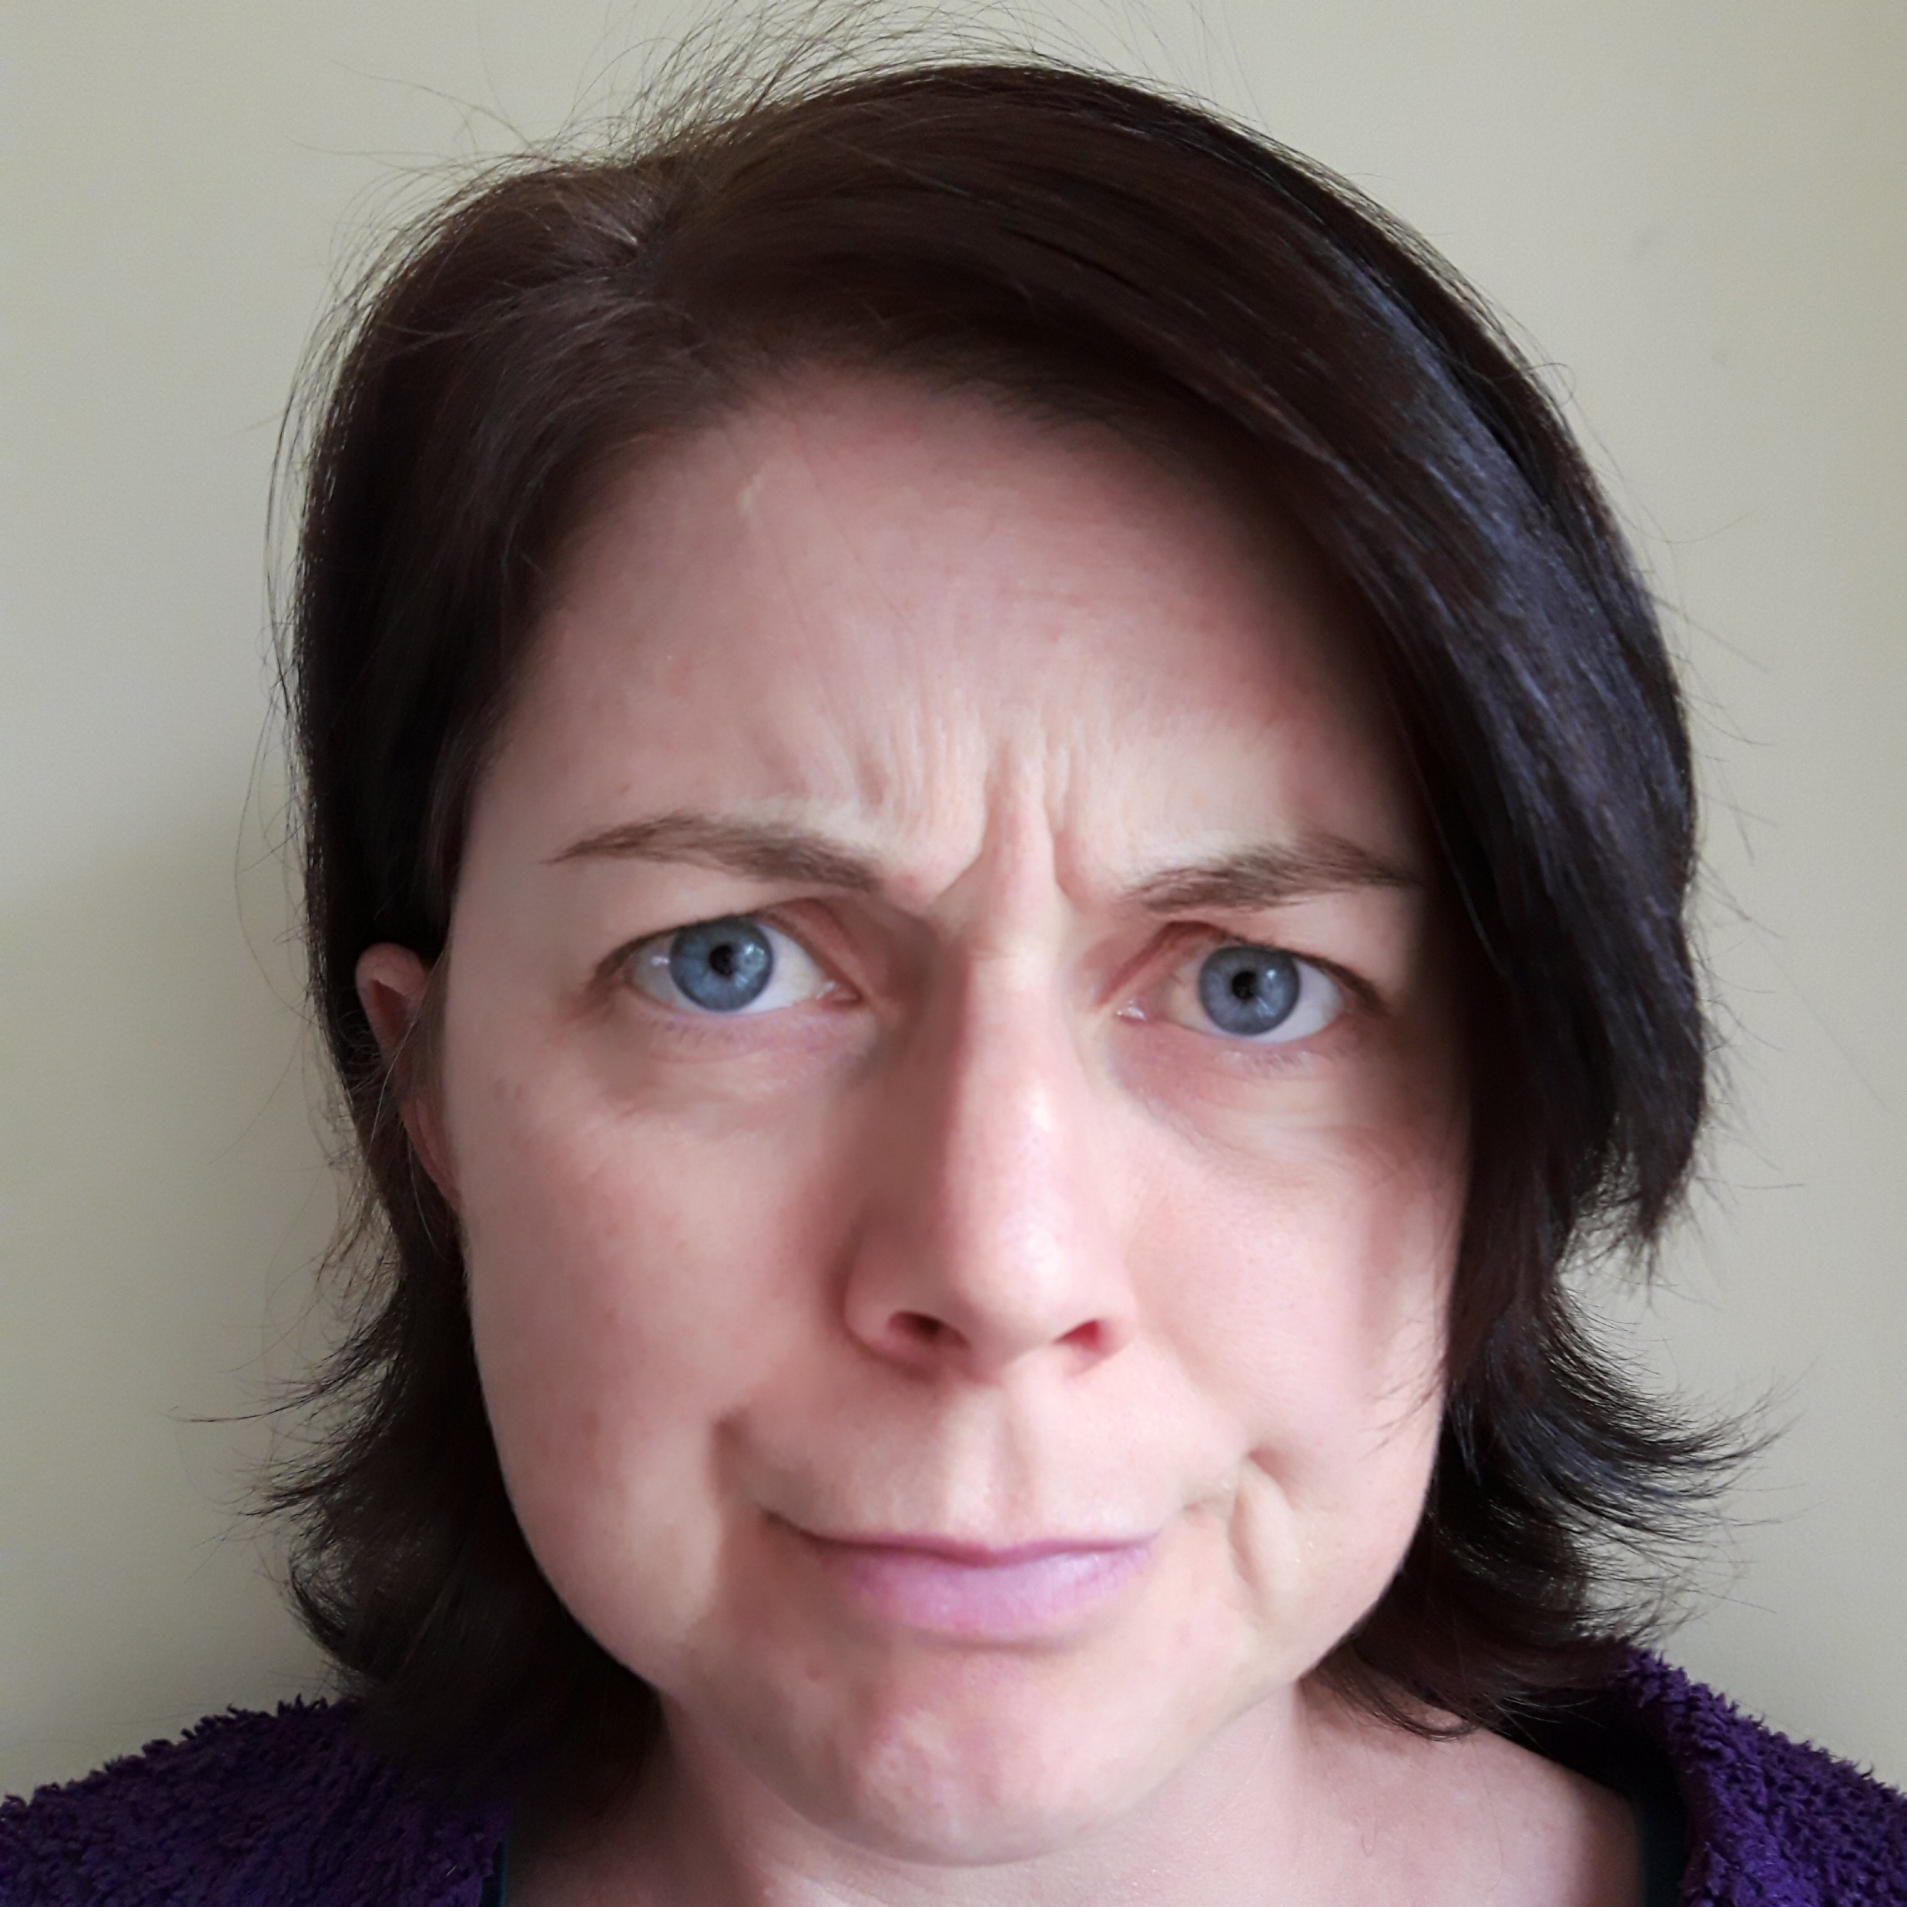
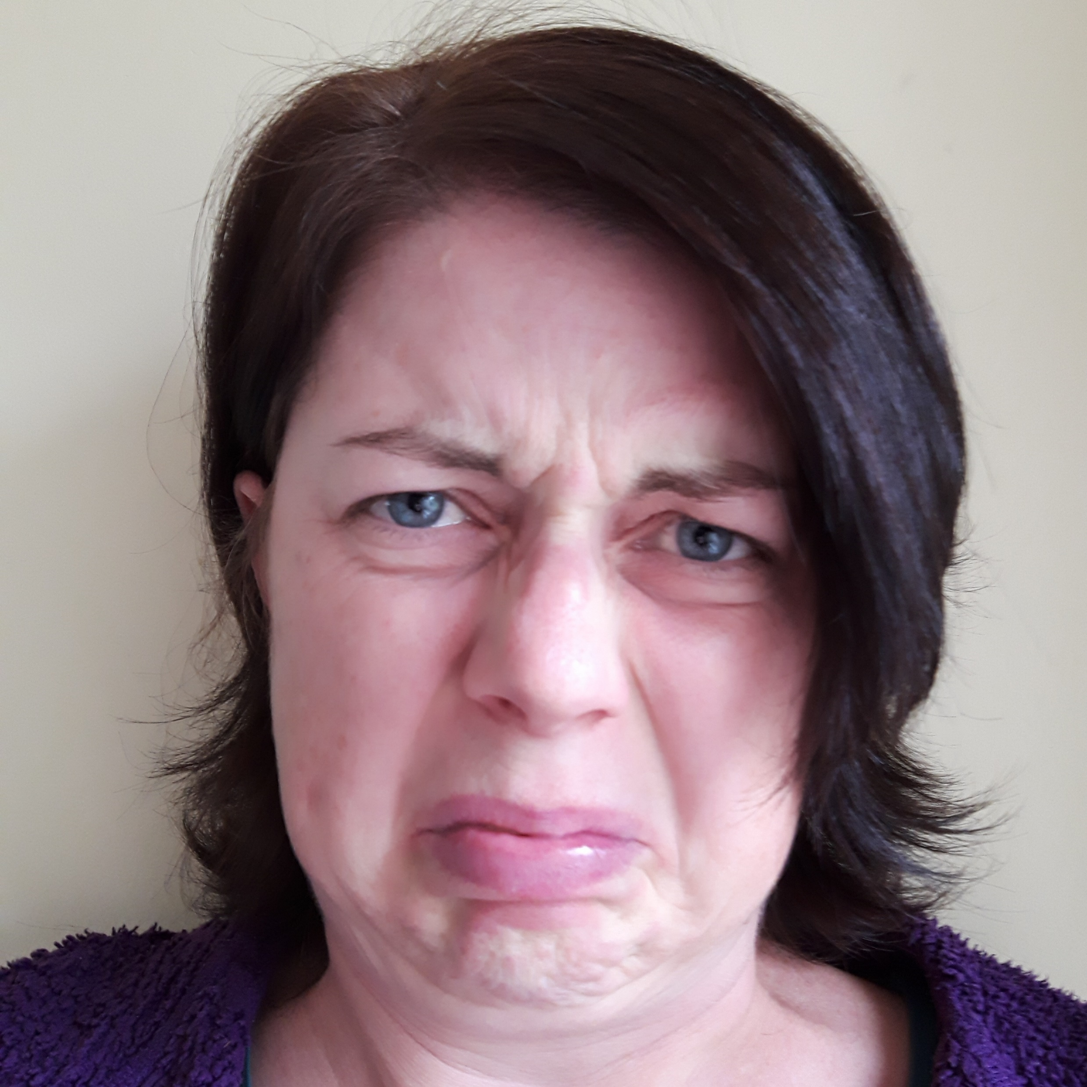
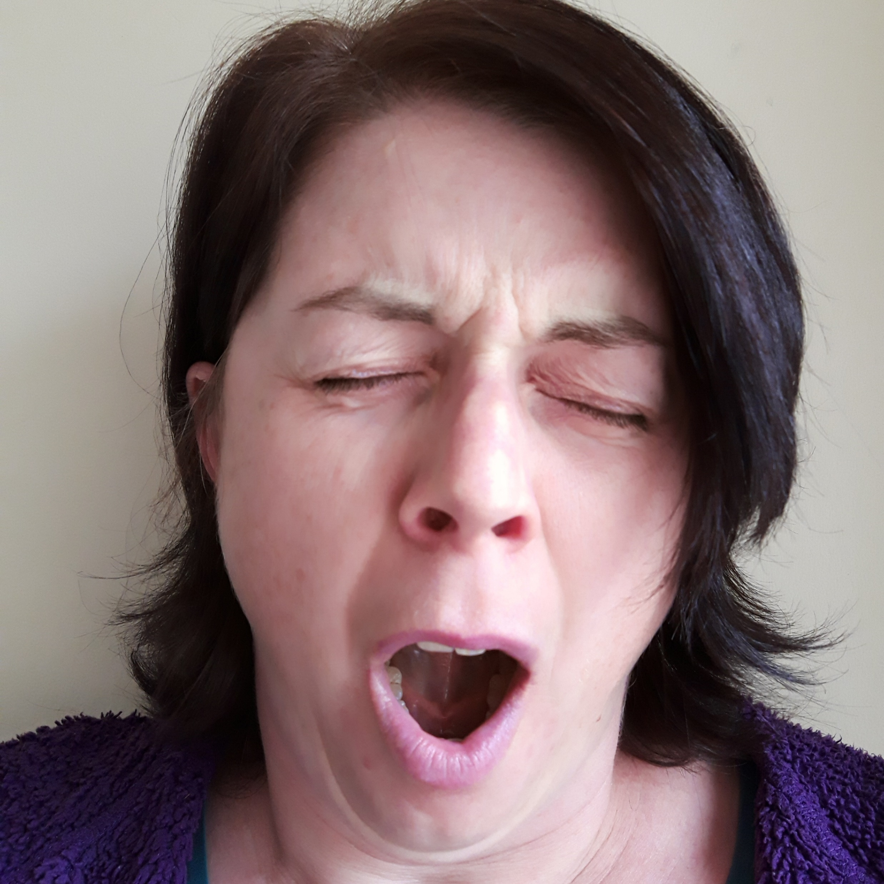
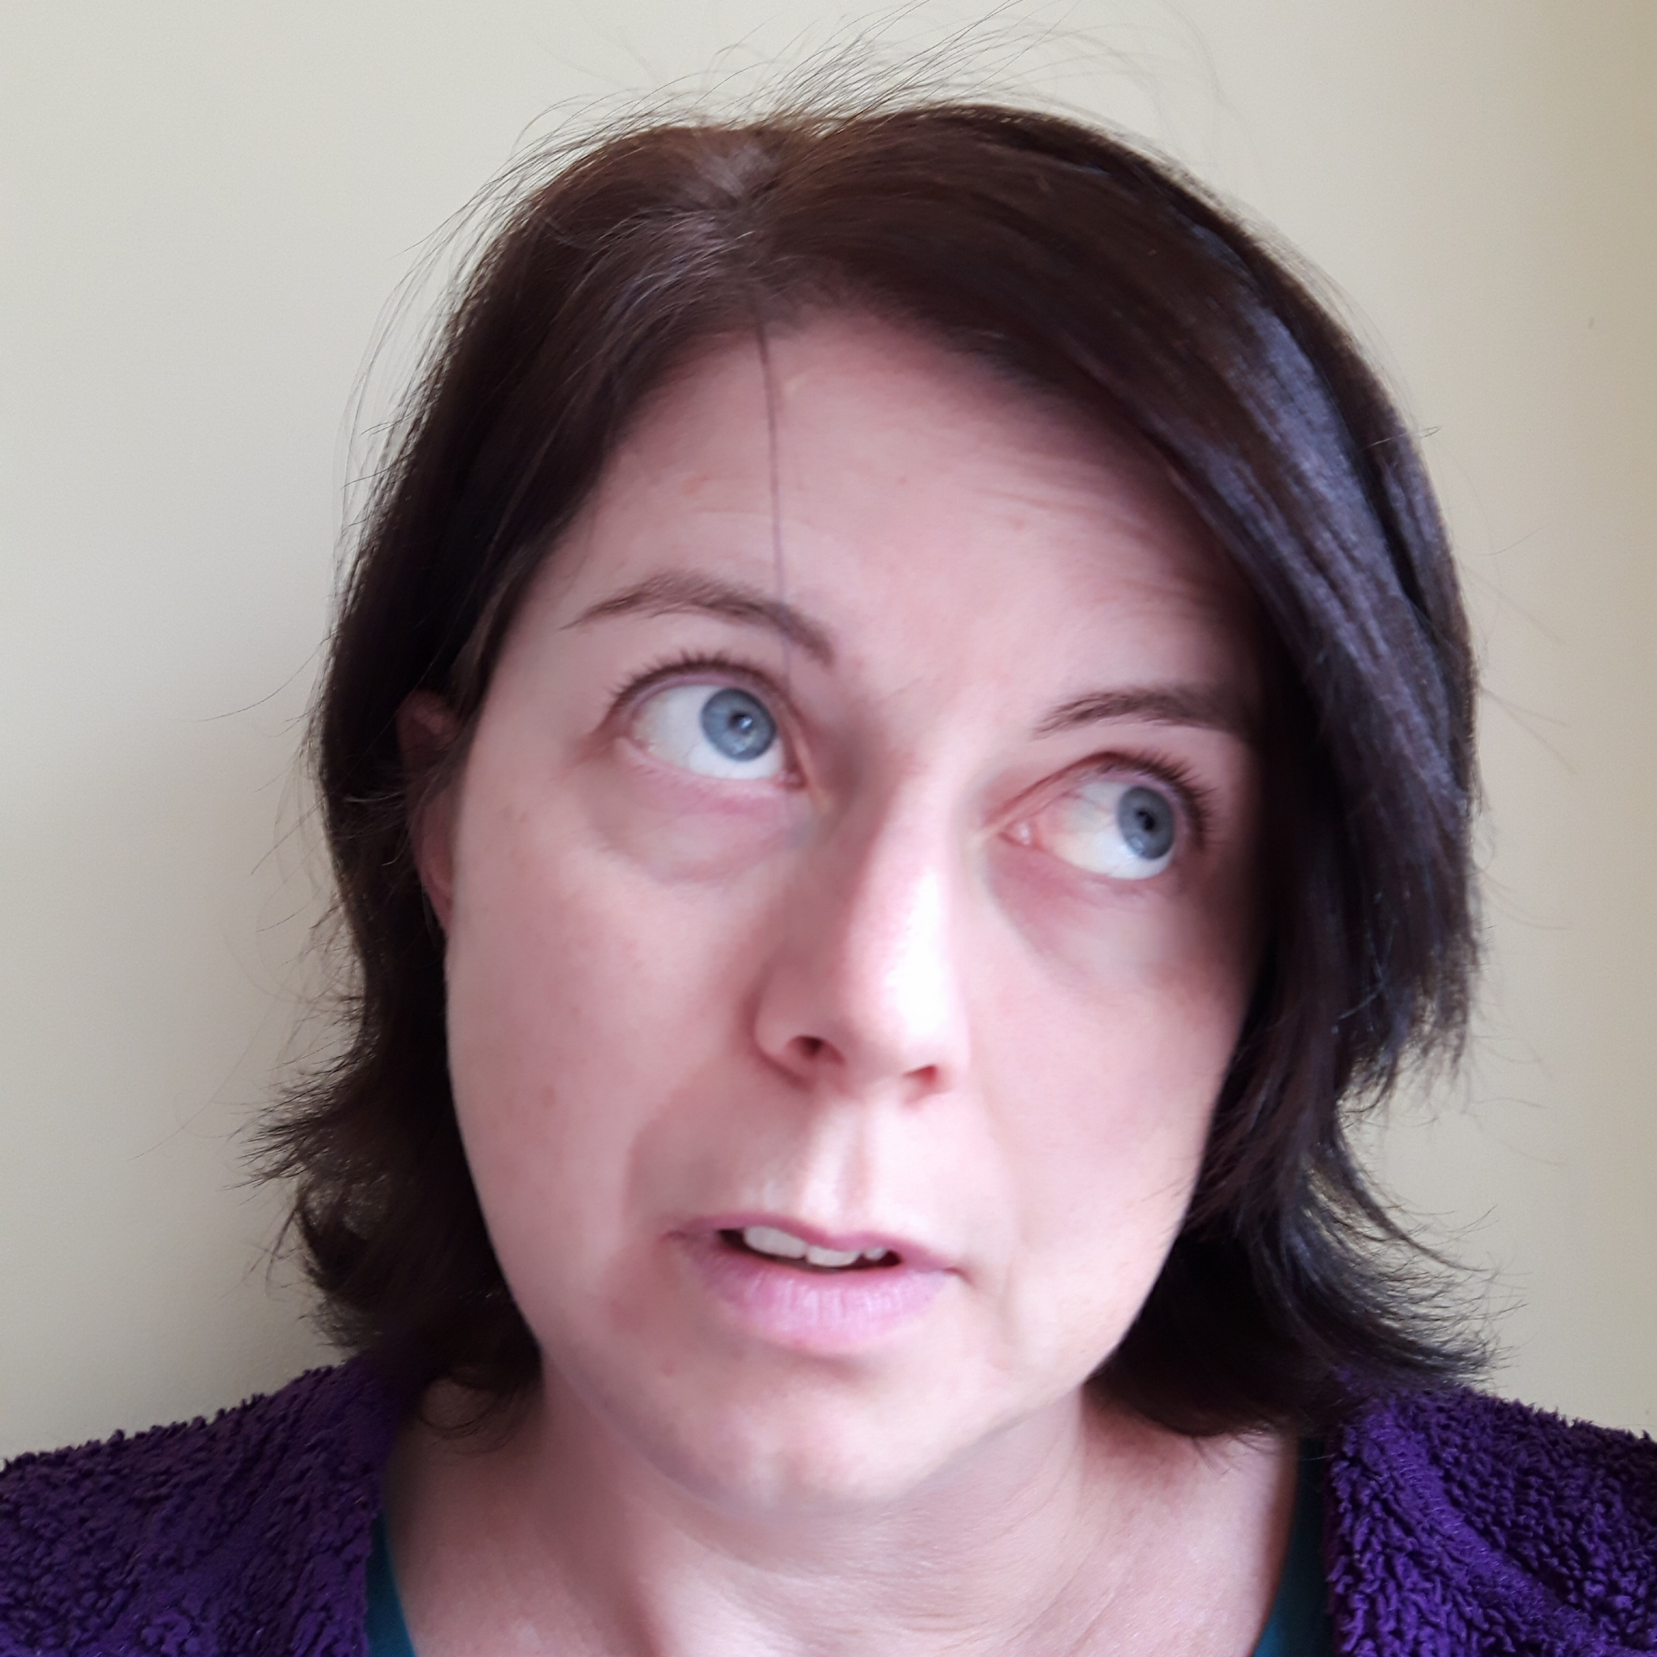
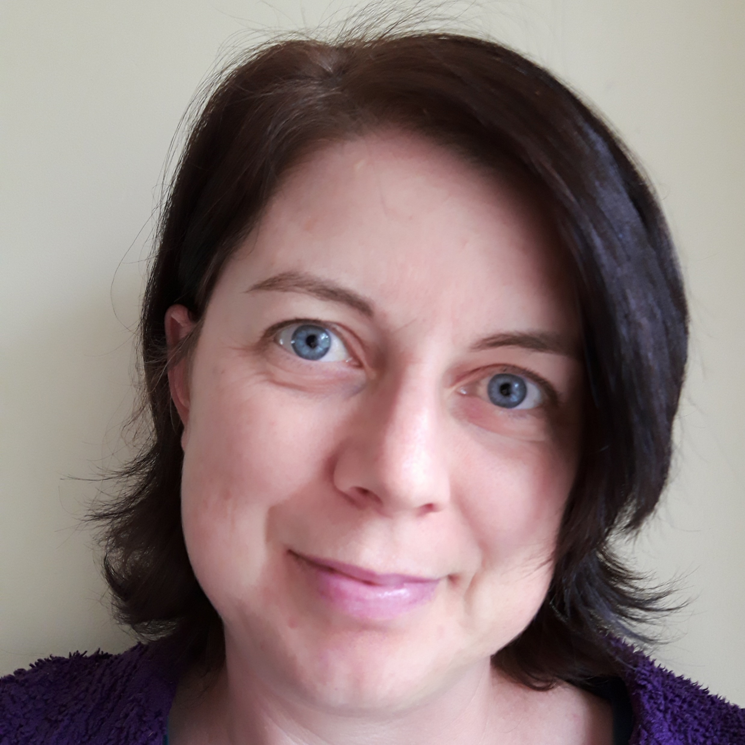
1
2
3
4
5
6
7
8
9
10
11
12

Slide 7
It’s time to share with the rest of the class!
Did you all come up with the same words…?
If not, why do you think that might be?
Are some people better at spotting emotions than others?
How could you get better at it?

Slide 8

Being able to recognise and identify emotions in ourselves and others is a true skill.
The better you get at it, the better your friendships will be, and the better you will understand your own needs.
Keep practising!
PS It also makes you WAY better at impressions…
Resource created by Jo Cotterill 2018

