Slide 1
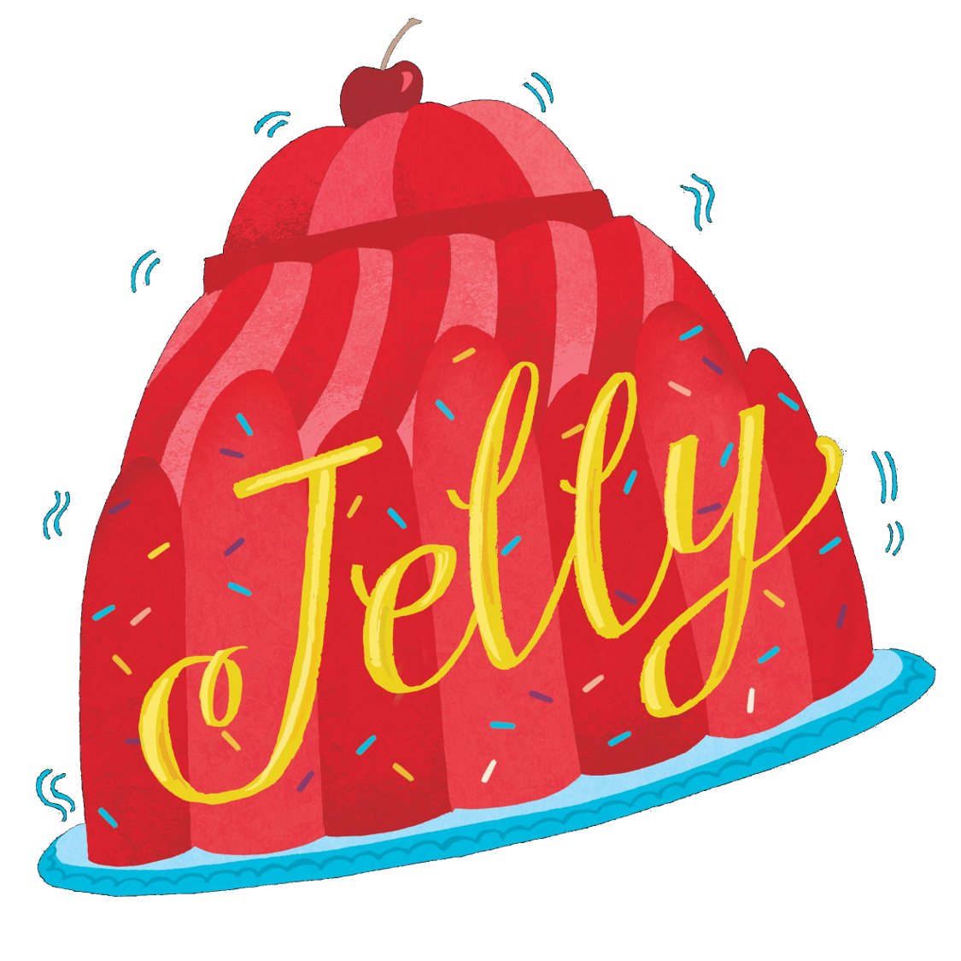
Create a Rhyming Poem

Slide 2
Rhyming poems are a lot harder to write than people think. It isn’t just about the word at the end of the line. A rhyming poem depends on scansion as well. Scansion is working out the rhythm of the poem – which syllables need to be stressed. (Not ‘stressed’ like ‘oh wow, I am so stressed right now’ but ‘emphasised’.)
Below is the scansion marked in Jelly’s poem People-watching on page 48:
I sit in the window and watch them go by
They shout and they giggle, they smile and they cry
Can you hear the rhythm? It is a kind of gallop: dee DUM diddy DUM diddy DUM diddy DUM. Every line fits this rhythm. (Except two! Can you identify them?)
If the scansion doesn’t work, you get something like this:
I sit in the window and watch them go by
Some of them are laughing and some of them cry
Can you see how this second line is wrong?

Slide 3
Now it’s your turn! Below is half a poem. The matching lines are missing.
Write out the lines provided, leaving a two-line gap between each one. You’re going to create the missing lines!
I sit by the window and look at the sky
My hands curl up tightly as feelings rush in
I wish I could be someone else for today
I can’t change the past but perhaps I can be
Author Jo’s Top Tip: When I’m writing a rhyming poem, I make a list of all the rhyming words I can think of before I start constructing the line. So for line 1, I would jot down: bye, cry, my, tie, why, lie, fly. Then I choose one that might fit and try to write a sentence around it. Sometimes it takes ages to come up with a good matching line! Don’t panic if you can’t do it straight away!

Slide 4
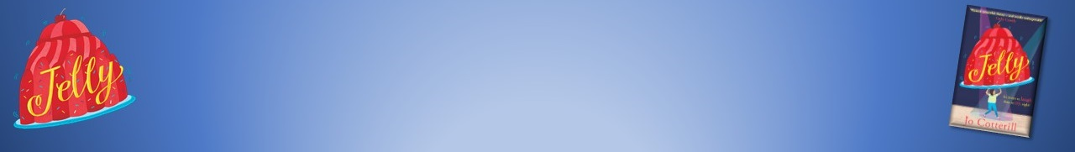
When everyone has finished, compare the completed poems.
Has everyone come up with something different?
Do all the matching lines have the correct scansion?
Which poems are more effective? (By ‘effective’, we mean ‘having an effect on the reader’ so if a poem makes you feel something strongly, then it is effective.) You’ll probably find that people prefer different ones. That’s because poetry is ‘subjective’ – everyone sees it differently. That’s OK!
Congratulations – you’re a poet!
Resource created by Jo Cotterill 2018

