Slide 1

Floorplans

Slide 2
When writing Jelly, it was important for author Jo Cotterill to know the layout of Jelly’s home, so that she could accurately describe the scenes that took place there.
On the next slide, you will see Jo’s drawing of the layout of Jelly’s flat. It’s not complete (some furniture is missing) and it’s not to scale, but it was enough for Jo to be able to write the scenes in the flat with accuracy.
Using graph paper and a ruler, can you draw a floorplan of your own house? If it has more than one floor, you might want to choose which one to draw.
To be extra clever, you could draw your floorplan to scale. You will need to measure the size of your rooms and convert the measurements for your diagram.

Slide 3
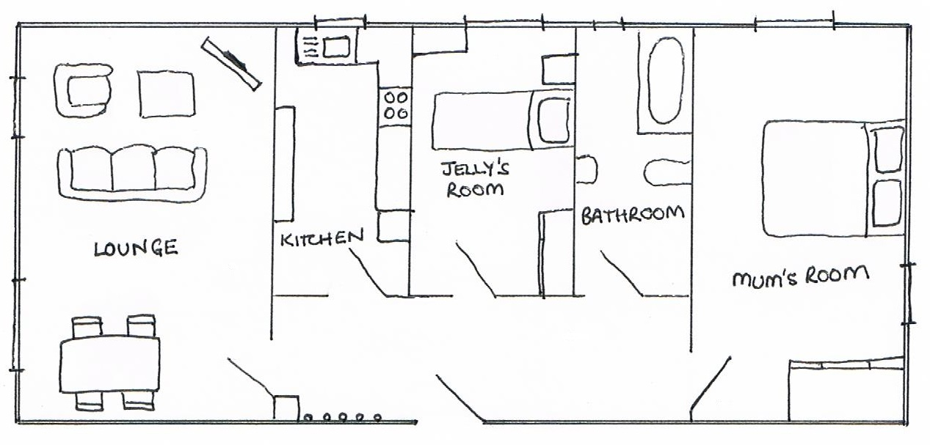
Jelly’s flat

Slide 4

Using graph paper and a ruler, can you draw a floorplan of your own house? If it has more than one floor, you might want to choose which one to draw.
To be extra clever, you could draw your floorplan to scale. You will need to measure the size of your rooms and convert the measurements for your diagram.
When finished, compare your floorplans with others in the class. Can you spot any similarities in the way the rooms are laid out?
Resource created by Jo Cotterill 2018

